Slide 1
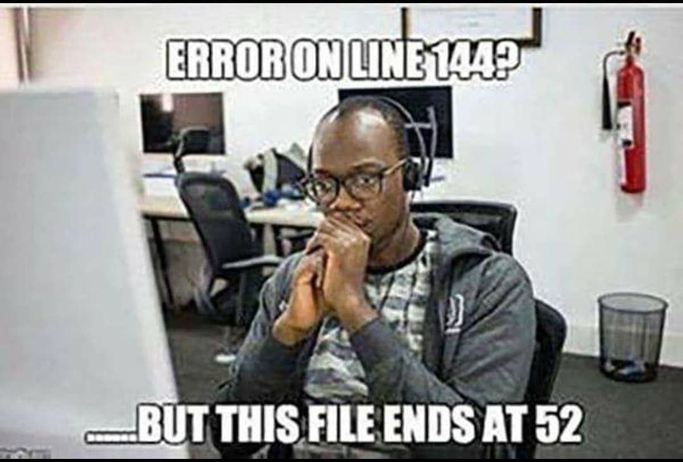
Expressions in PHP

Slide 2


Slide 3
What is Expression?
The term "expression" in programming refers to a combination of symbols and elements that, when evaluated, produce a value.

Slide 4
Arithmetic Expression
Arithmetic expressions involve mathematical operations and can include addition, subtraction, multiplication, division, modulus, and exponentiation.

Slide 5
Arithmetic Expressions
$a = 10;
$b = 5;
$sum = $a + $b;
$difference = $a - $b;
$product = $a * $b;
$quotient = $a / $b;

Slide 6
“People hate on PHP because it’s cool to hate on PHP and most of those most likely haven’t written a line of PHP”

Slide 7
Do you know?
There was no formal specification/standard for php till 2014.

Slide 8
String Expression
String expressions manipulate and concatenate strings, which are sequences of characters.
$firstName = "John";
$lastName = "Doe";
$fullName = $firstName . " " . $lastName;

Slide 9
Comparison Expressions
Comparison expressions evaluate to boolean values based on comparisons between variables or values.
$x = 10;
$y = 5;
$isGreater = ($x > $y);

Slide 10
What is an expression in programming?
A) A comment explaining the purpose of a code block.
B) A sequence of statements that perform a specific task.
C) A combination of values, variables, operators, and/or function calls that can be evaluated to produce a value.
D) A loop that repeats a block of code a certain number of times.

Slide 11
C) An expression is a combination of values, variables, operators, and/or function calls that can be evaluated to produce a value. It represents a computation or a data manipulation task.

Slide 12
Logical Expressions
$isTrue = true;
$isFalse = false;
$logicalAnd = ($isTrue && $isFalse);
$logicalOr = ($isTrue || $isFalse);

Slide 13
Ternary Expression
The ternary operator (? :) is a concise way to write simple conditional expressions. It has the form condition ? true_expression : false_expression. It's a powerful tool for assigning values based on a condition.

Slide 14
Ternary Conditional Expression
$age = 18;
$isAdult = ($age >= 18) ? "Yes" : "No";

Slide 15
Array Expressions
$numbers = array(1, 2, 3, 4, 5);
$sumArray = array_sum($numbers);
$countArray = count($numbers);

Slide 16
Precedence and Grouping
$result = 2 * (3 + 4); // This ensures addition is done before multiplication

